Slide 1
Philanthropy New York Neighborhoods Count: Using Data to Transform High Poverty Neighborhoods
Mon, Nov 16, 2015 @ 10am

Slide 2
CHLDC
Years in operation: 32
Budget: $13.7 million
Number of people served annually: over 10,000
Youth Development: Our afterschool programs serve 1,350 students a year, and have been recognized for excellence through an Afterschool Innovator Award
Economic Opportunity: We are partnering with JobsFirst NYC, pioneering a sectoral employment program for young adults in logistics and transportation,
Affordable Housing: We have developed 400 units of affordable housing in the community, creating homes
for both renters and owners.

Slide 3
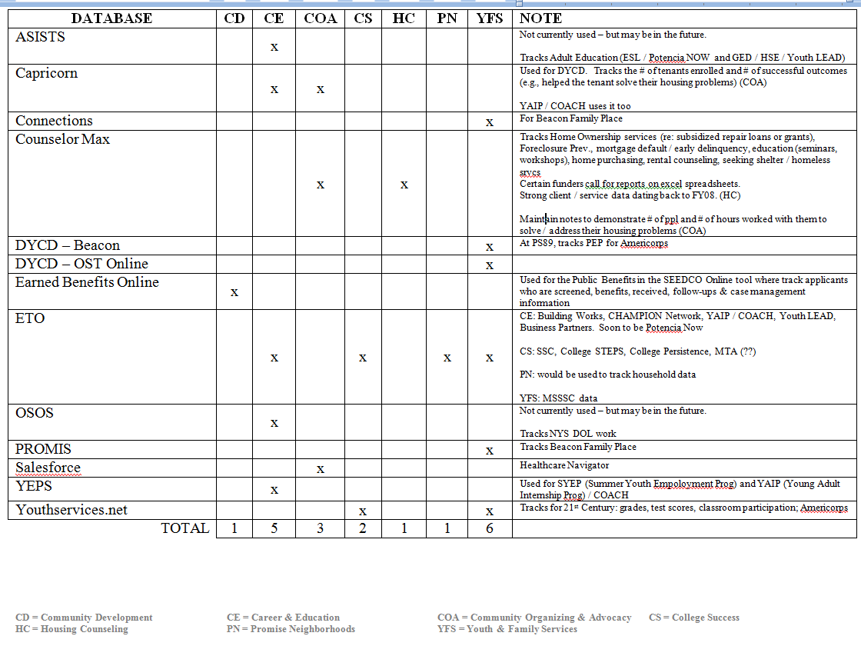
Program Databases (n=13)

